Slide 1

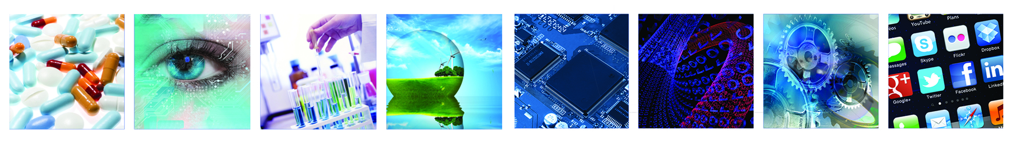
2nd IATI MNC Weekathon
Demo Day

Slide 2
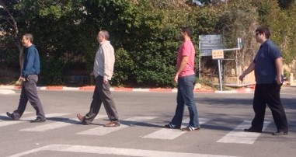



Blind-Phone Project
Adi Eldar
Microsoft ILDC
Shai Rubin
Citi Innovation Lab
Kfir Tishbi
Citi Innovation Lab
Igor Lyakas
GE HealthCare

Slide 3
Blind Phone – Background
We were looking for
Social purpose
Image processing
Mobile application
Idea: Use everyday device to help the blind. Challenge: crossing a road without a guiding dog and without voice assistance

Slide 4
Blind Phone – Background
Capture
Analyze
Voice Alert

Slide 5
Blind Phone – Background
Isolated Storage
High Ramp Up
WindowsPhone8
Encoding
Pixel format
Image Processing
FitScreen
Performance
Testing
Re:Play

Slide 6
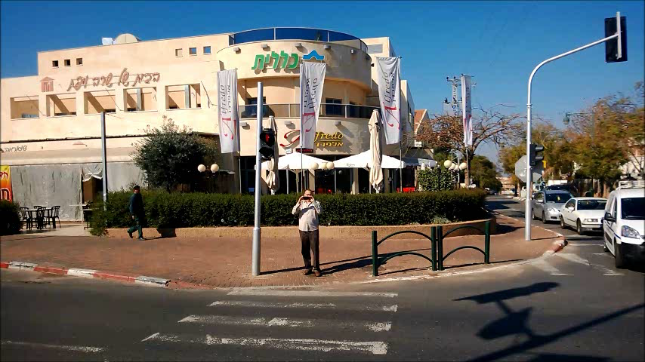
The Blind Phone Use Case

Slide 7
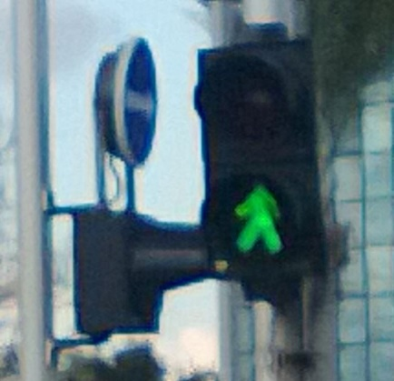
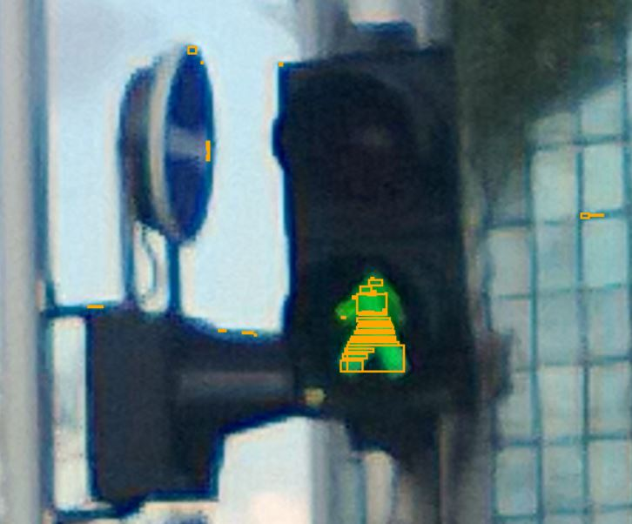
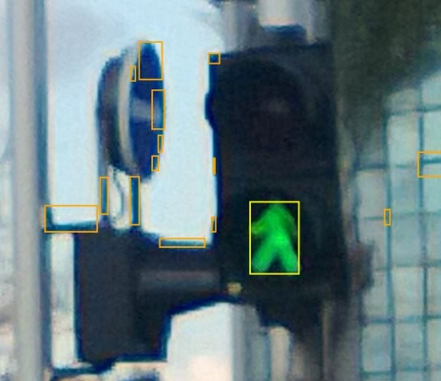
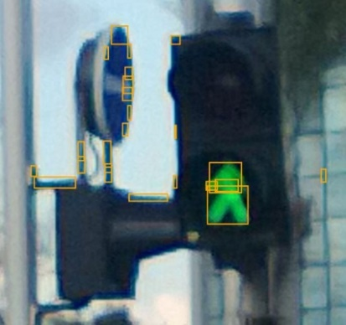
Image Segmentation Algorithm
Initial Traffic light Image
Find Red or Green Pixels
Group Adjacent Objects
Dilate The Objects

Slide 8
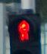
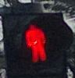
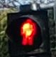
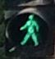
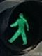
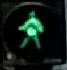
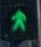
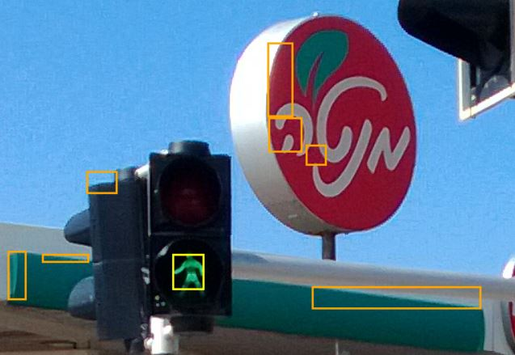
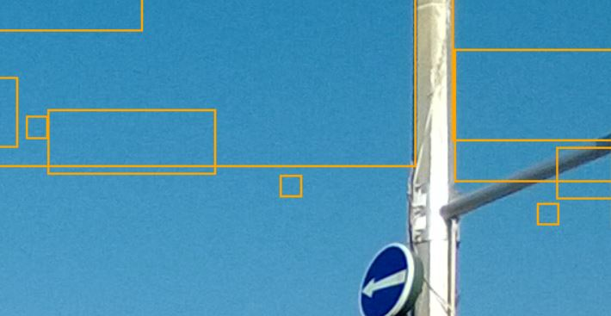
Red/Green Color Filter
RGB color ranges for Red & Green lights vary, due to day light, shading, age
We need to expand Red & Green color ranges in order to avoid missing traffic light pixels
Higher sensitivity leads to marking other pixels that fall into the same color range
Sometimes, even clear sky pixels fall into the green window

Slide 9
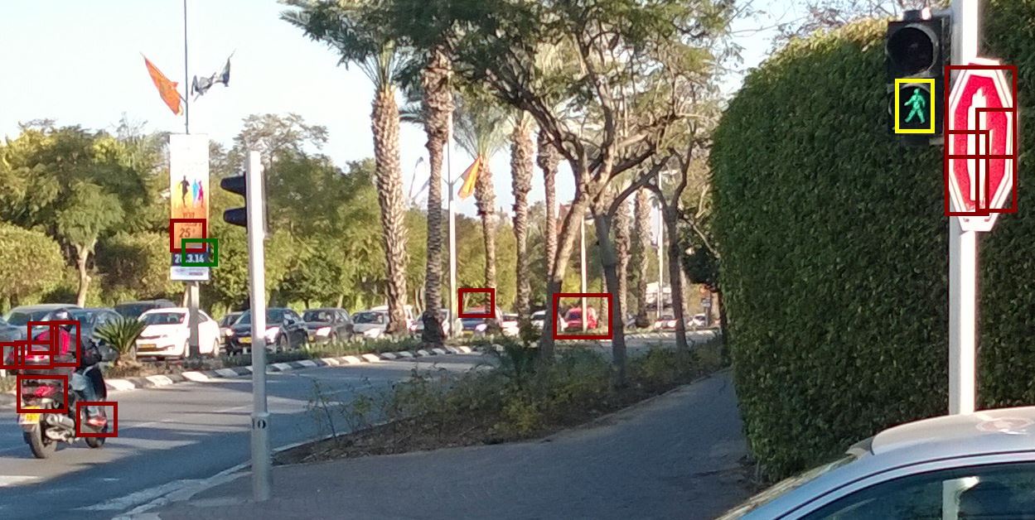
Objects list: Need to filter many False Positives

Slide 10
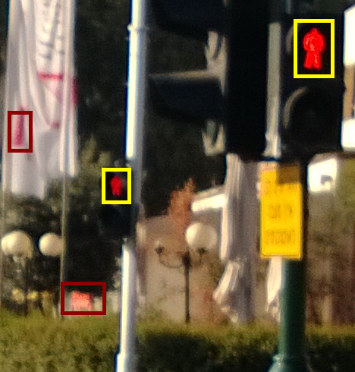
Size filter
Depends on the distance from the traffic light (which depends on the width of the street)
Still can be used to filter out much too small/too big objects

Slide 11
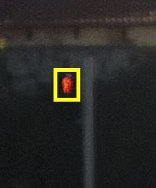
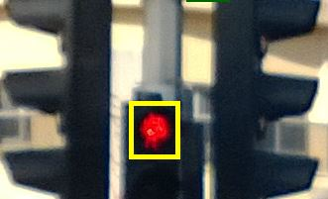
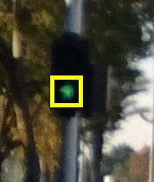
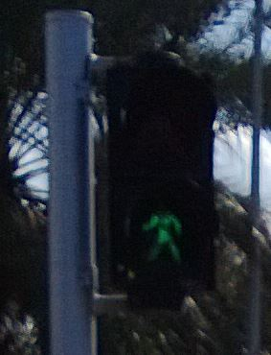
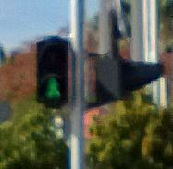
Shape filter
Practically unreliable due to aged light & blurred image
Still might be used to check simple morphology like portrait aspect ratio

Slide 12
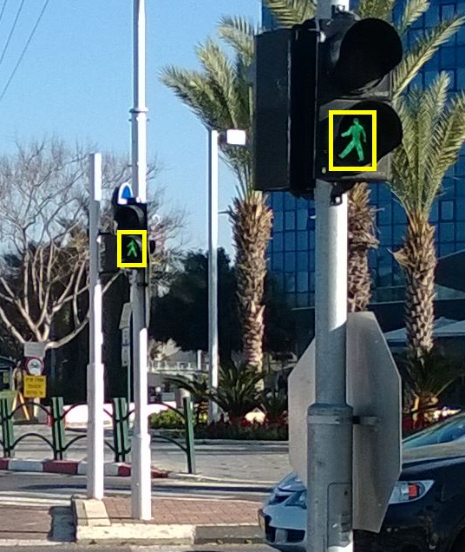
Location filter
Analyze only specific horizontal strip of the image (e.g. top half, middle third etc.)
But the phone is not necessarily held in vertical position (can be solved by reading the accelerometer)

Slide 13
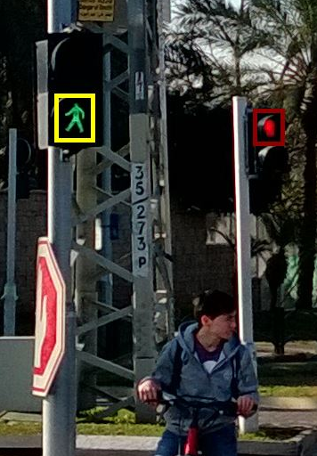
“Black Other” filter
For red/green object, look for a black region with similar shape below/above the object
Very effective (and size invariant)
Sensitive to direct sun light or night

Slide 14
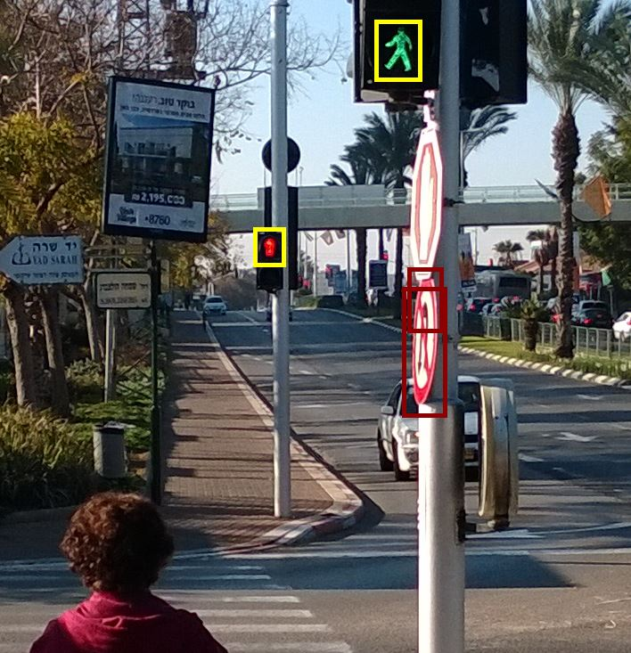
Ambiguity filter: both Red & Green
The closer light is the important one
Assuming both lights are at the same height, the closer one would be higher in the image

Slide 15
Live Demo
Simulation from real captured images saved on the Windows Phone Isolated Storage

Slide 16
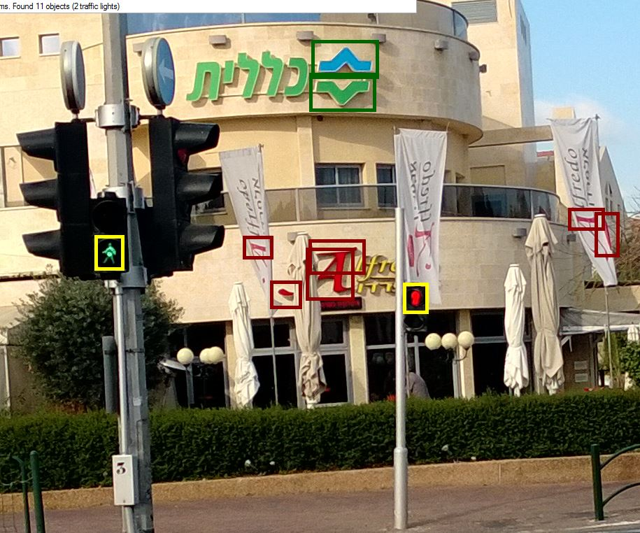
Summary – Blind Phone
Proud on the social goal
Proud on the team work
Proud on a working POC
Thanks for RedHat !!
Thanks for IATI for arranging Developer Heaven:
Work on the problem you choose
With professionals
With recent technologies

